Slide 1
PMM Consulting
Pranav Katariya, Masoom Patel, Max Sobkov

Slide 2
Business Problem?
Client – Xfinity Inc.
Who will pay for our “lightning” Internet?
How should we reach out to them?
No Problem :)
Notes:
Q1 Determines if worth doing project

Slide 3
Feature Selection
What Entertainment media does your household use?
Do you ever binge watch shows?
Do you use Internet for social or personal Interests?
Employment status : student or non-student

Slide 4
Deloitte Digital Democracy Survey
comes to rescue
25 Questions on :
Demographics - Age, Location, Ethnicity, Children etc.
Digital Content Consumption
Notes:
habits of US consumers—seeking to improve our understanding of the shifting attitudes and behaviors that involve entertainment devices, advertising, media consumption, social media, and the Internet.

Slide 5
Feature Selection Contd.
Do you play video games while watching media?
What is your income?
Do you plan to buy any entertainment products in the next 12 months?
What subscriptions do you have/prefer?
Notes:
Q3 is outcome of modeling

Slide 6
Notable Exclusions
No demographics
Age
Gender
U.S. State
Ethnicity etc.
Notes:
Things like Advertise to the Millenials doesn't work anymore.

Slide 7
Exploratory Data Analysis

Slide 8
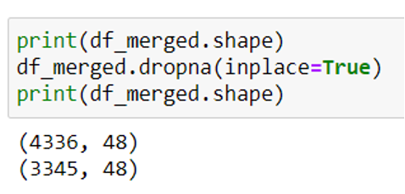
Data Cleaning
Merged data from 2010 & 2011. 2009?
Removed rows with null survey answers
23% of the Data Dropped - 3345 samples still significant

Slide 9
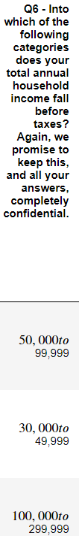
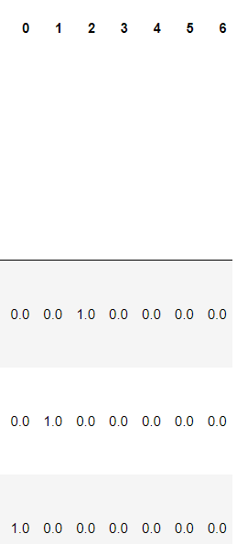
One Hot Encoding

Slide 10
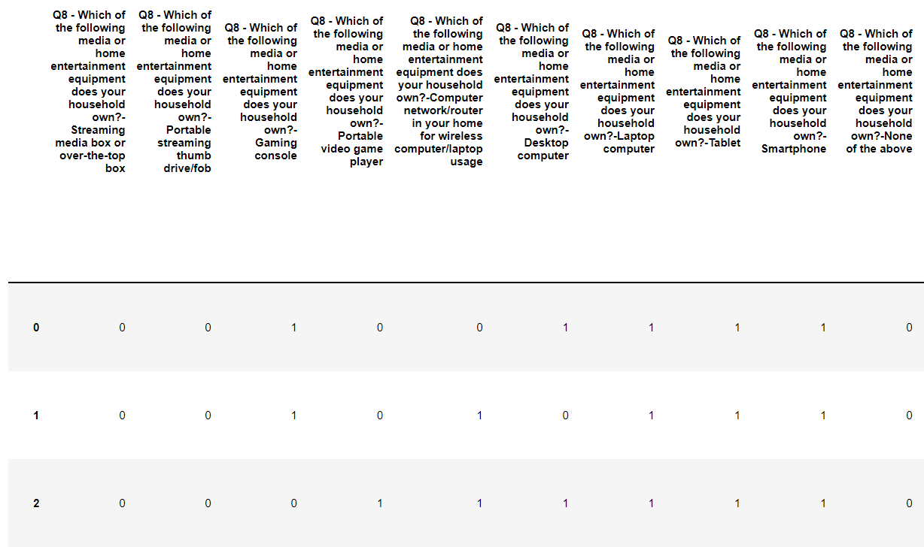
Binary Encoding
Notes:
Binary encoding makes modeling easier for numerical models

Slide 11
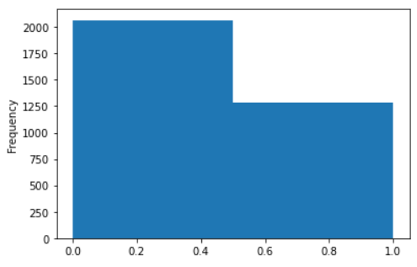
Target Variable
Interest in paying for faster internet

Slide 12
Modeling
Supervised Learning

Slide 13
Consistent Parameters
All supervised learning
90/10 Train/Test Split
Fixed random seed (42)

Slide 14
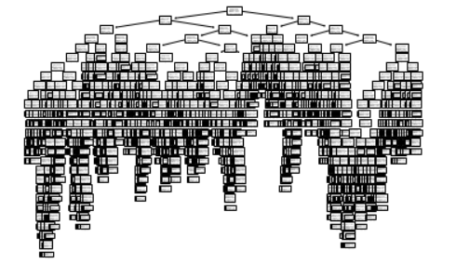
Decision Tree
Notes:
Ummm, yea...

Slide 15
Decision Tree
YIKES!
Notes:
Ummm, yea...

Slide 16
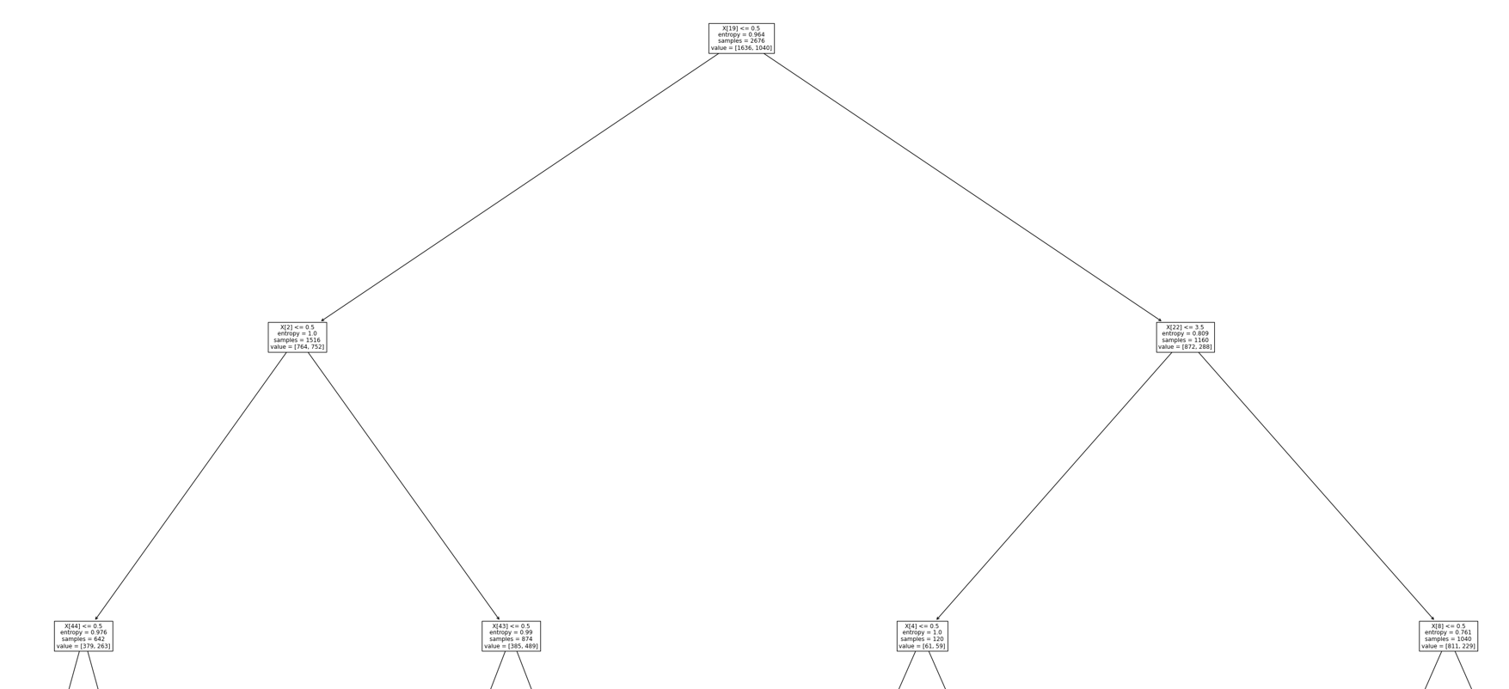
Decision Tree(Zoomed in)
Q10) Which of the following do you plan to purchase in the next 12 months?
Response: None of options
Notes:
Accuracy 52.68%

Slide 17
Approach After Tree
Tried many different models
Compared accuracies
Look into the best model

Slide 18
Other Methods
Random Forest
Support Vector Machines
K-Nearest Neighbors
Gradient Boosting
Naive Bayes
Logistic Regression

Slide 19
Other Methods
Random Forest - 49.25%
Support Vector Machines - 68.96%
K-Nearest Neighbors - 66.87%
Gradient Boosting - 69.85%
Naive Bayes - 69.55%
Logistic Regression - 71.04%

Slide 20
Other Methods
Random Forest - 49.25%
Support Vector Machines - 68.96%
K-Nearest Neighbors - 66.87%
Gradient Boosting - 69.85%
Naive Bayes - 69.55%
Logistic Regression - 71.04%

Slide 21
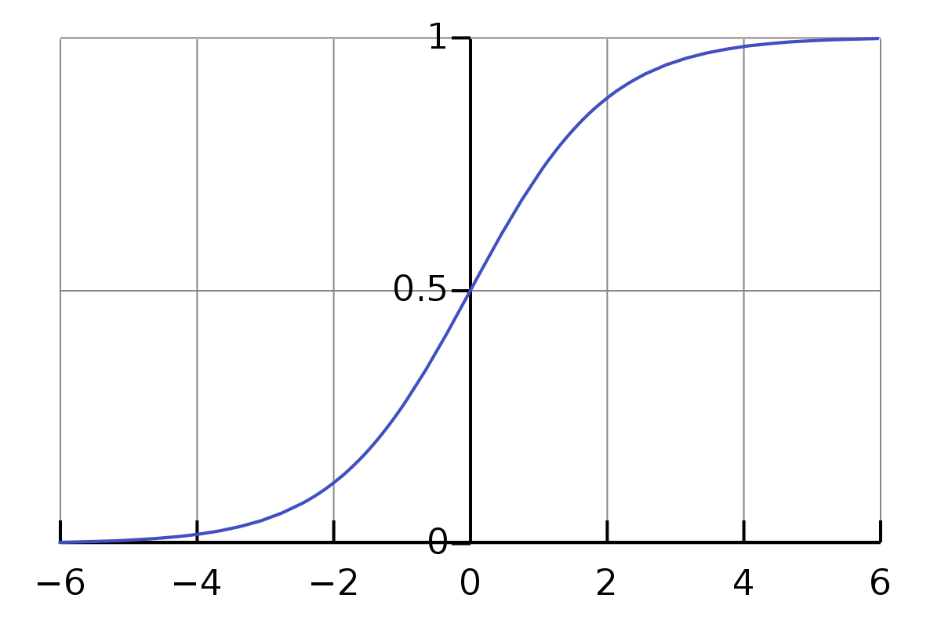
Logistic Regression
Simpler Model
Explainability high
Excellent for binary classification

Slide 22
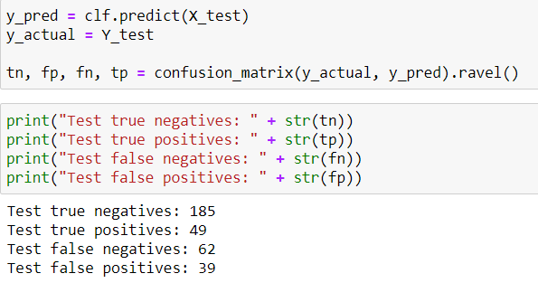
Further Validation

Slide 23
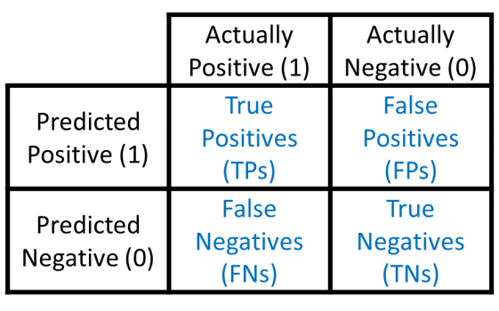
Reflection on Modeling
More false negatives than true positives
Point is to extract important predictors
49
39
62
185

Slide 24
Reflection on Features
Data usage / fixed time period
Work from home
Companies

Slide 25
Conclusions

Slide 26
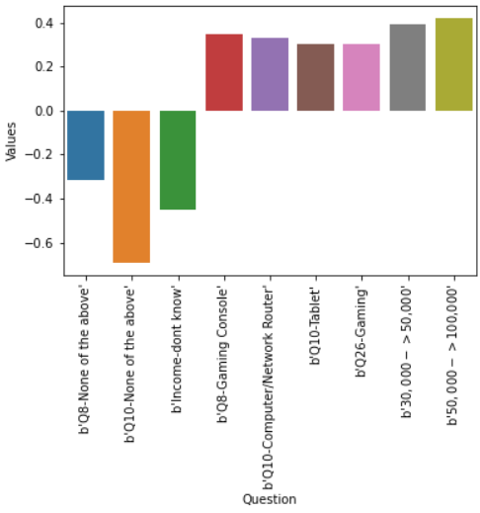
Most Important Predictors

Slide 27
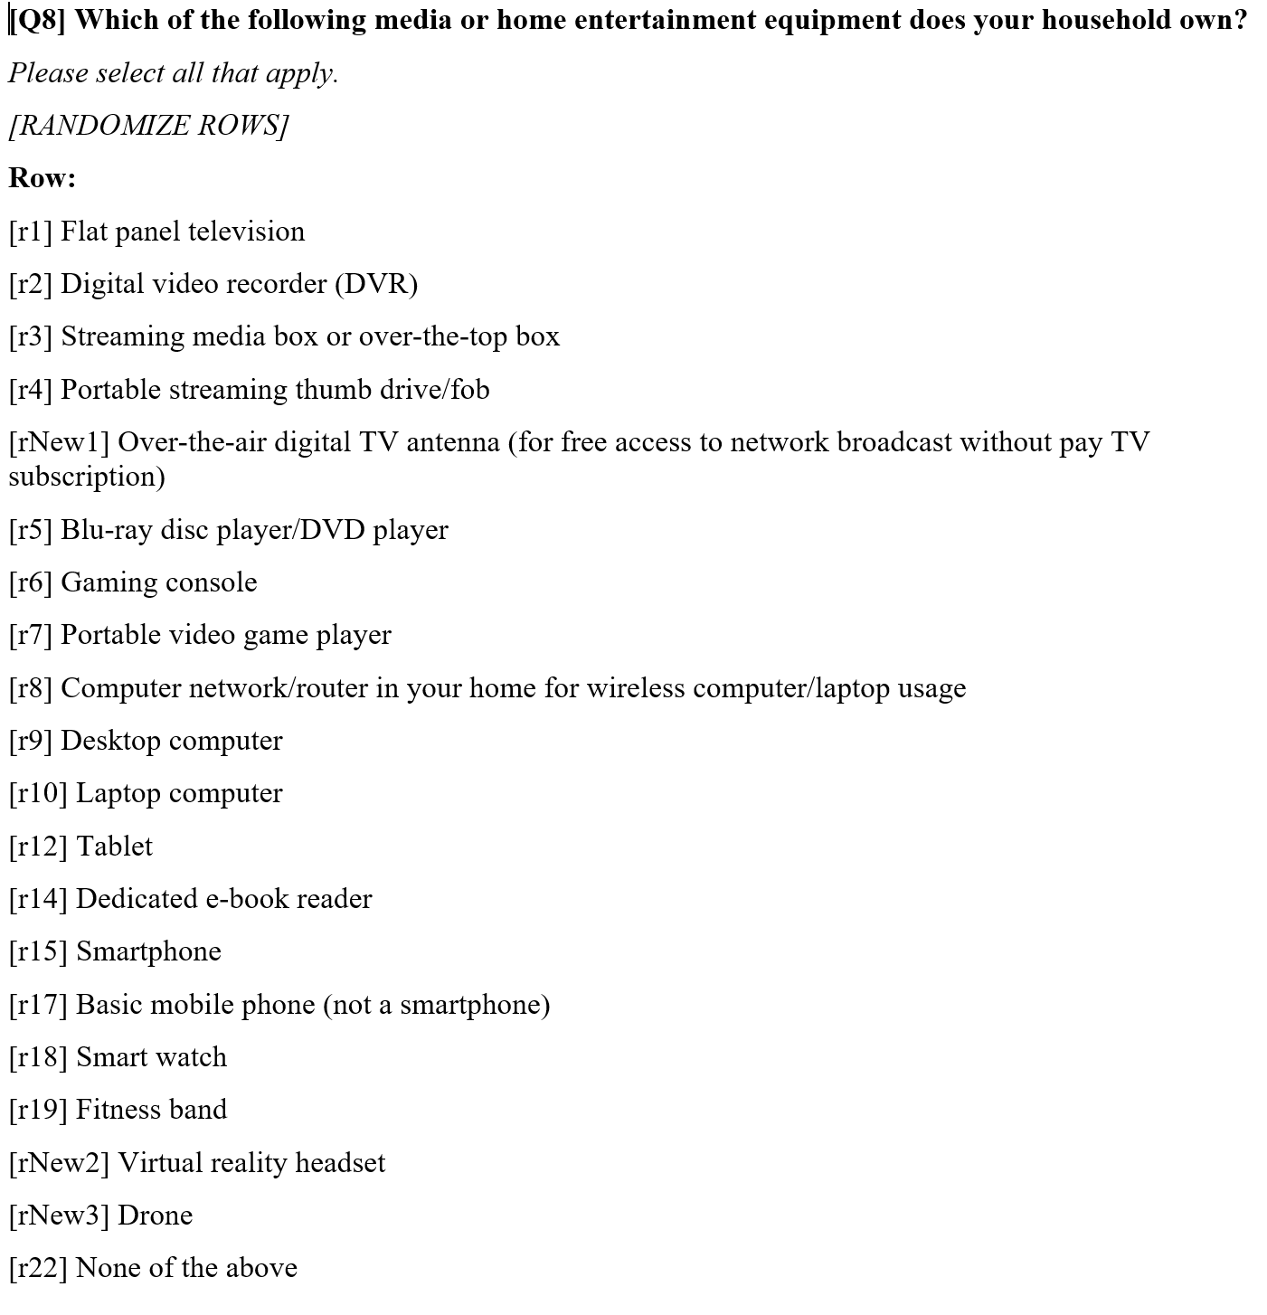

Slide 28
Most Important Predictors
[Q10] Of those products you indicated you do not currently own, which of the following do you plan to purchase in the next 12 months?

Slide 29
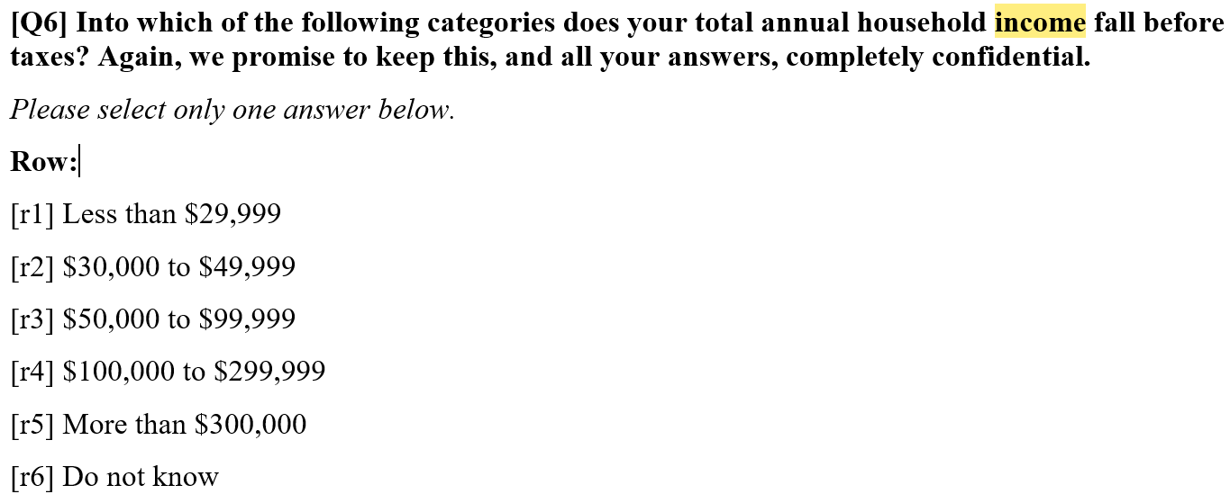
Most Important Predictors

Slide 31
Most Important Predictors
[Q10] Of those products you indicated you do not currently own, which of the following do you plan to purchase in the next 12 months?

Slide 32
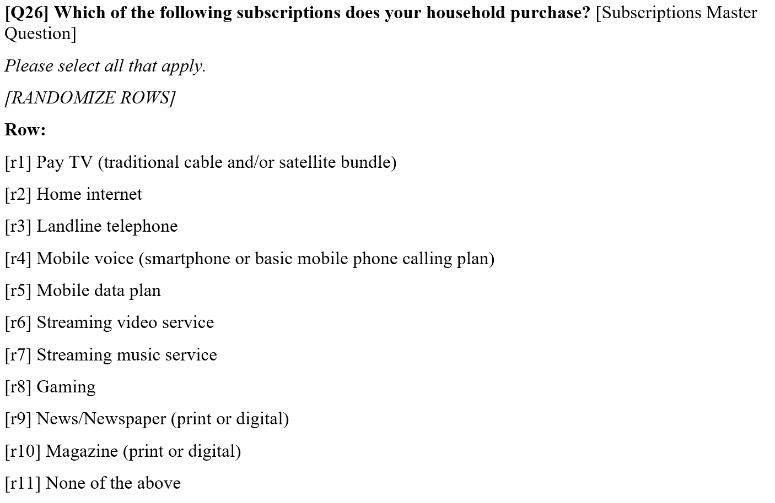

Slide 33
Most Important Predictors

Slide 34
Recommendations
Advertise to $30,000 - $100,000 income
Bundle with Tablets (Ipad, Surface Pro, etc)
Bundle with Routers (Cisco, TP-Link, etc)
Advertise in Gaming forums (Twitch, Discord, Gaming conventions)

Slide 35
Thank You!
Before Q&A,
let’s ANALYZE your survey results

